Slide 1
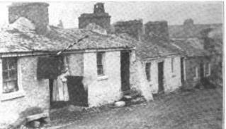
A Sense of Place:
Researching local placenames and streetscapes

Slide 2
Why are placenames of significance?
Eighth United Nations Conference on the Standardization of Geographical Names Berlin, 27 August-5 September 2002 Item 17 (a) of the provisional agenda - The social and cultural value of place names. Submitted by Norway
“Place-names are an important part of our geographical and cultural environment. They identify geographical entities of different kinds and represent irreplaceable cultural values of vital significance to people’s sense of well-being and feeling at home. Place-names are therefore of major social importance”.

Slide 3
Why are placenames of significance?
Irish Ordnance Survey:
“The basic function of a placename is to establish identity and to assist communications. Placenames are a valuable part of our cultural inheritance.
The history of placenames in the Ordnance Survey began in November 1824 when the first survey of Ireland by the British Ordnance Survey commenced. The survey was at a scale of 6 inches to one mile”.

Slide 4
Economic considerations of placenames:
Interest in ancestry and tracing roots / Cultural tourism
Ireland Reaching Out (IrelandXO), formed in 2010, now has 150,000 members worldwide, connecting Irish parishes with the local diaspora & those of Irish heritage
In 2013, the Year of ‘The Gathering’ – 250k to 275k additional visitors generating an estimated revenue of €170m
In 2016, website Ancestry.co.uk reported 40% surge in access due to Brexit & a desire to attain an Irish passport
Programme for Government contains commitment to 2023 for the Global Welcome Initiative, marking the 10th anniversary of ‘The Gathering’

Slide 5
Case study: Ballinasloe, County Galway
Located between Athlone town and Galway City, derives its’ name from ‘Béal Átha na Sluaigh’ or the ‘ford of the mouth of the hostings / gatherings (a reference to the gatherings that took place in medieval times along the ‘highway’ that was the local river).

Slide 6
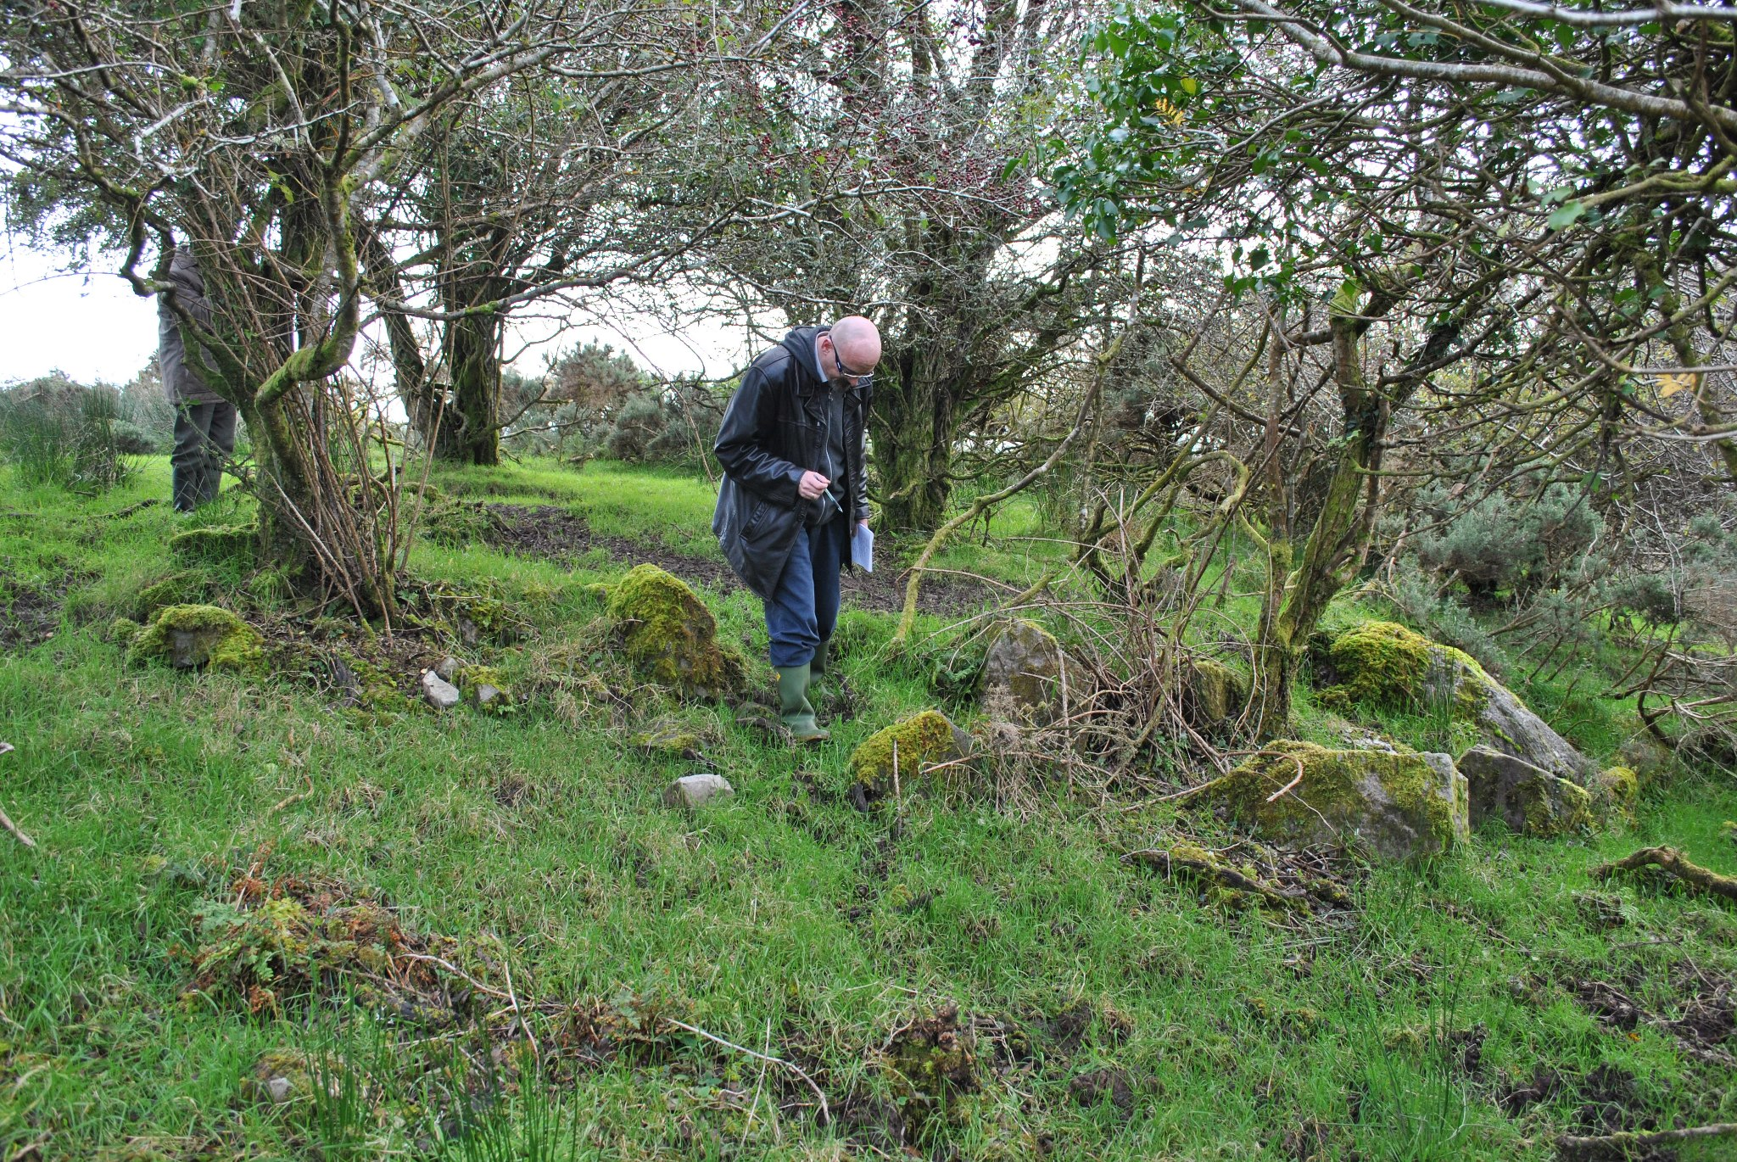
“It is not the literal past, the 'facts' of history, that shape us, but images of the past embodied in language” (Brian Friel, Translations)

Slide 7
Letter to the earl of Derby, 1855
Reference is made to “ … the evangelical town of Ballinasloe, formerly called by the Popish name of Kylenaspithogue …”
‘Béal Átha na Sluaigh’ or the ‘ford of the mouth of the hostings / gatherings
‘Popish’ reference seems to imply a view of Catholicism as being bound up with superstition and therefore that the name was bestowed through a link with folklore rather than history

Slide 8
Kylenaspithogue
Derives from the ‘wood of the robin’
The robin features prominently in Irish folklore – belief that it was present at the Crucifixion
Association with death & burial
Therefore likely associated in the older naming of Ballinasloe with a place of burial

Slide 9
‘Caltrehard’ / the high burial place

Slide 10
Name of Catrehard changed to Brackernagh in the late 18th century
Excavations in the mid-twentieth century revealed evidence of an extensive burial ground from medieval times
The change of name coincided with the purchase of huge swathes of land by Frederick Trench. The land covered by Caltrehard was convenient to the the Trench estate and so we have a ‘remaking’ of the local landscape with an end to the centuries-old practice of burial at this site
Name deliberately erased
The change of name may be seen as part of the colonial endeavour
“But remember that words are signals, counters. They are not immortal. And it can happen – to use an image you’ll understand – it can happen that a civilization can be imprisoned in a linguistic contour which no longer matches the landscape…of fact”. Brian Friel, Translations
Caltrehard = the high burial place / Brackernagh – the speckled land

Slide 11
Two distinct cultural entities in local placenames
Those that are there from time immemorial and reflect Gaelic identification
Those that come in the post-medieval period and which reflect the colonial endeavour

Slide 12
Ballinasloe: 1837 - 2023
Main Street – by 1837 it had become two arteries - Main & Dunlo St
Back Street - Tea Lane between 1820 & 1923 – changed to Jubilee St
Soldiers’ Row – changed to Society St in 1845
Rutledge’s Lane – built 1820s – gone by 1939
Piper’s Lane – built 1820s – gone by 1939
Boulger’s Lane built 1820s – name still exists
The Kennels / Newtowngaffy – built 1820s – gone by 1939
Harbour Lane – changed to Hymany St in 1946
Church Lane – changed to Victoria St in 1887 – to Duggan Ave 1946

Slide 13
Most extensive name change in 1946 at the behest of the local branch of the Gaelic League
Harbour Lane renamed Hymany Street
Victoria Street renamed Duggan Avenue
Reeves Lane renamed Davitt Place
Agricultural Lane renamed Emmett Place
A previously unnamed thoroughfare named as Sarsfield Road
Market Square renamed St Michael’s Square
An entirely unoccupied section of land named MacNevin Avenue
The Burma Road, named through whimsy, became Harris Road

Slide 14
Name changes in 1946 caused some complications
The Connacht Tribune, 1st June 1946 stated that the new names would be “a welcome change from the old practice of naming streets after the loyal servants of England”
YET none of the previous names in Ballinasloe commemorated any well-known English figure
All of the new names were inscribed on plaques in the Irish language only which created a deal of confusion for years afterwards, especially for visitors who did not know the language
All of the old names commemorated what might be called ‘old nationalism’ with little local connection on the parts of any of these patriots. No great conversation about these figures afterwards
To this day, older residents of the town will still refer to some streets and lanes by the older names

Slide 15
None of those commemorated were of recent vintage
Patrick Sarsfield – died 1693
Bishop Patrick Duggan – died 1896

Slide 16
None of those commemorated were of recent vintage
Robert Emmett – died 1803
Dr William MacNevin - died 1841

Slide 17
None of those commemorated were of recent vintage
Matt Harris – died 1890
Michael Davitt – died 1906

Slide 18
Researching post-medieval placenames & street names and understanding their cultural & social significance
The principal sources are:
Cartographic – maps of different eras will indicate changing placenames & variations of names
Census Returns – vital for local renditions of placenames
For Ireland – the field-notes of John O’Donovan, who worked with the Ordnance Survey in the mid-nineteenth century
Civil records – births, marriages & deaths – in Ireland most of these date from 1864 onwards
Online historic newspaper archives – local renderings of names are often given via what the local correspondent gleaned from residents

Slide 19
Placenames – social & cultural significance
They bestow a sense of place on locals
They are vital in assisting lineal & collateral descendants of former residents of areas in tracing their roots
They preserve a link to the past & often point to the origin of the area being studied
They often reveal something of the social environment in which residents functioned
They influence the way in which we think about a particular point on the landscape or within the streetscape

Slide 20
Recommendations:
Students or researchers:
Take as a case study a data-set of three towns from a discrete such as East Galway & compile data on each
Compare the likely origin of all the place or street names in each town
Try to suggest on the basis of the historical evidence what may have given rise to the name
Look for consistency or change in names & draw conclusions
Promote this information for the benefit of historical researchers & cultural tourism purposes

Slide 21
Remember that names can be deceiving as in the case of Paradise Row!

